Slide 1
Chapter 7
Triggers and Active Databases

Slide 2
Trigger Overview
Element of the database schema
General form: ON <event> IF <condition> THEN <action>
  Event- request to execute database operation
  Condition - predicate evaluated on database state
  Action – execution of procedure that might involve database updates
Example: ON updating maximum course enrollment IF number registered > new max enrollment limit THEN deregister students using LIFO policy

Slide 3
Trigger Details
Activation - Occurrence of the event
Consideration - The point, after activation, when condition is evaluated
  Immediate or deferred (when the transaction requests to commit)
  Condition might refer to both the state before and the state after event occurs

Slide 4
Trigger Details
Execution – point at which action occurs
  With deferred consideration, execution is also deferred
  With immediate consideration, execution can occur immediately after consideration or it can be deferred
    If execution is immediate, execution can occur before, after, or instead of triggering event.
    Before triggers adapt naturally to maintaining integrity constraints: violation results in rejection of event.

Slide 5
Trigger Details
Granularity
  Row-level granularity: change of a single row is an event (a single UPDATE statement might result in multiple events)
  Statement-level granularity: events are statements (a single UPDATE statement that changes multiple rows is a single event).

Slide 6
Trigger Details
Multiple Triggers
  How should multiple triggers activated by a single event be handled?
    Evaluate one condition at a time and if true immediately execute action or
    Evaluate all conditions, then execute actions
  The execution of an action can affect the truth of a subsequently evaluated condition so the choice is significant.

Slide 7
Triggers in SQL:1999
Events: INSERT, DELETE, or UPDATE statements or changes to individual rows caused by these statements
Condition: Anything that is allowed in a WHERE clause
Action: An individual SQL statement or a program written in the language of Procedural Stored Modules (PSM) (which can contain embedded SQL statements)

Slide 8
Triggers in SQL:1999
Consideration: Immediate
  Condition can refer to both the state of the affected row or table before and after the event occurs
Execution: Immediate – can be before or after the execution of the triggering event
  Action of before trigger cannot modify the database
Granularity: Both row-level and statement-level

Slide 9
Before Trigger Example
(row granularity)
Check that enrollment ≤ limit
CREATE TRIGGER Max_EnrollCheck
BEFORE INSERT ON Transcript
REFERENCING NEW AS N --row to be added
FOR EACH ROW
WHEN
((SELECT COUNT (T.StudId) FROM Transcript T
WHERE T.CrsCode = N.CrsCode
AND T.Semester = N.Semester)
>=
(SELECT C.MaxEnroll FROM Course C
WHERE C.CrsCode = N.CrsCode ))
ABORT TRANSACTION

Slide 10
After Trigger Example
(row granularity)
No salary raises greater than 5%
CREATE TRIGGER LimitSalaryRaise
AFTER UPDATE OF Salary ON Employee
REFERENCING OLD AS O
NEW AS N
FOR EACH ROW
WHEN (N.Salary - O.Salary > 0.05 * O.Salary)
UPDATE Employee -- action
SET Salary = 1.05 * O.Salary
WHERE Id = O.Id
Note: The action itself is a triggering event (but in this case a
chain reaction is not possible)

Slide 11
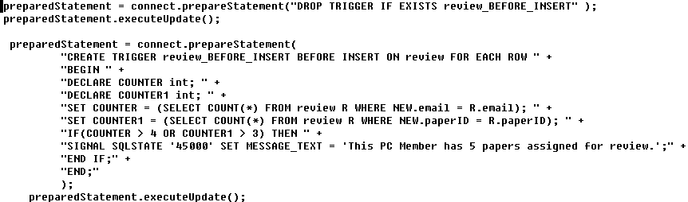
Trigger Example In Java
Keep track of salary averages in the log
Courtesy of Popy Aziz and Leslie Aririguzo

Slide 12
After Trigger Example
(statement granularity)
Keep track of salary averages in the log
CREATE TRIGGER RecordNewAverage
AFTER UPDATE OF Salary ON Employee
FOR EACH STATEMENT
INSERT INTO Log
VALUES (CURRENT_DATE,
SELECT AVG (Salary)
FROM Employee)

Slide 13
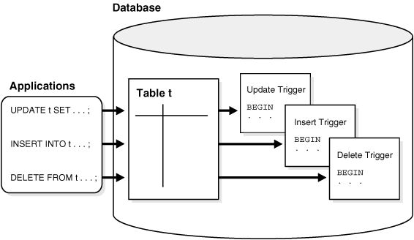
Oracle Triggers

Slide 14
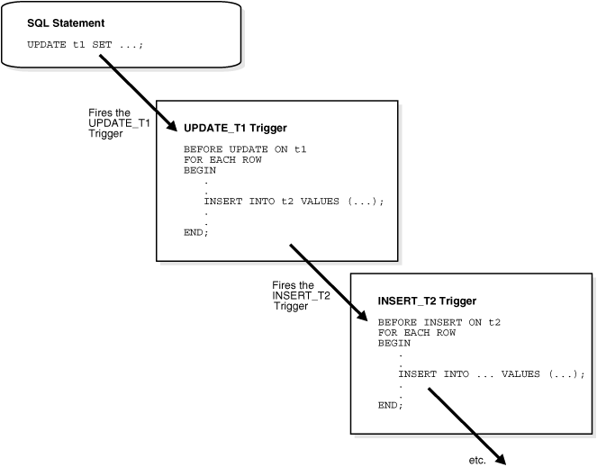
Cascading Triggers

Slide 15
Cascading Triggers

Slide 16
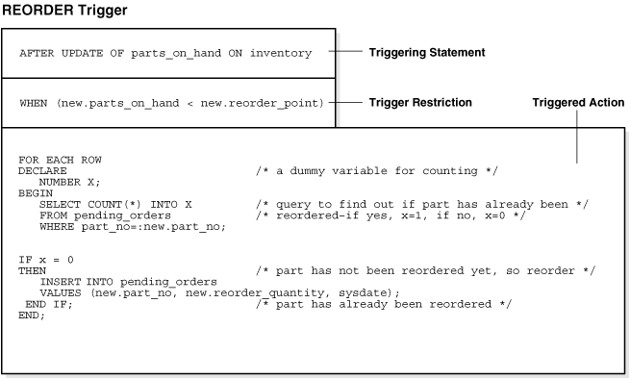
An example

Slide 17
More information about Oracle triggers
http://download.oracle.com/docs/cd/B19306_01/server.102/b14220/triggers.htm#CNCPT017

